Slide 1
Traffic Sign Classification Ryan Talbot
Notes:
“Hello everyone. My name is Ryan Talbot and today I’ll be presenting my DTSA 5511 Deep Learning Final Project: Traffic Sign Classification for Autonomous Driving using the German Traffic Sign Recognition Benchmark (GTSRB). The goal of this project was to classify 43 types of traffic signs to support real-time decision-making in autonomous vehicles.”

Slide 2
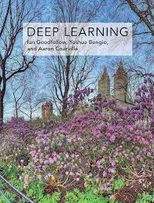
Project analysis slide 11
Problem Statement & Importance
Notes:
“Traffic sign recognition is critical for self-driving cars. A misclassification could lead to unsafe driving decisions. The GTSRB dataset is a well-known benchmark containing images of German traffic signs captured under varied lighting, angles, and occlusions. The challenge: achieving accurate classification across 43 classes while meeting constraints for real-time inference.”

Slide 3
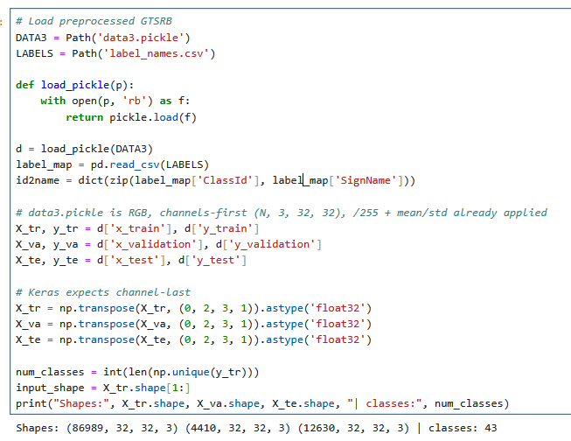
Project analysis slide 11
Data Source & Loading
Notes:
“I used Kaggle’s preprocessed GTSRB data—specifically data3.pickle, which contains normalized RGB images and labels—and label_names.csv for mapping class IDs to sign names. The dataset was split into ~87k training, 4.4k validation, and 12.6k test images, each sized 32×32×3. Because Keras expects channel-last format, I transposed from (N,3,32,32) to (N,32,32,3).”

Slide 4
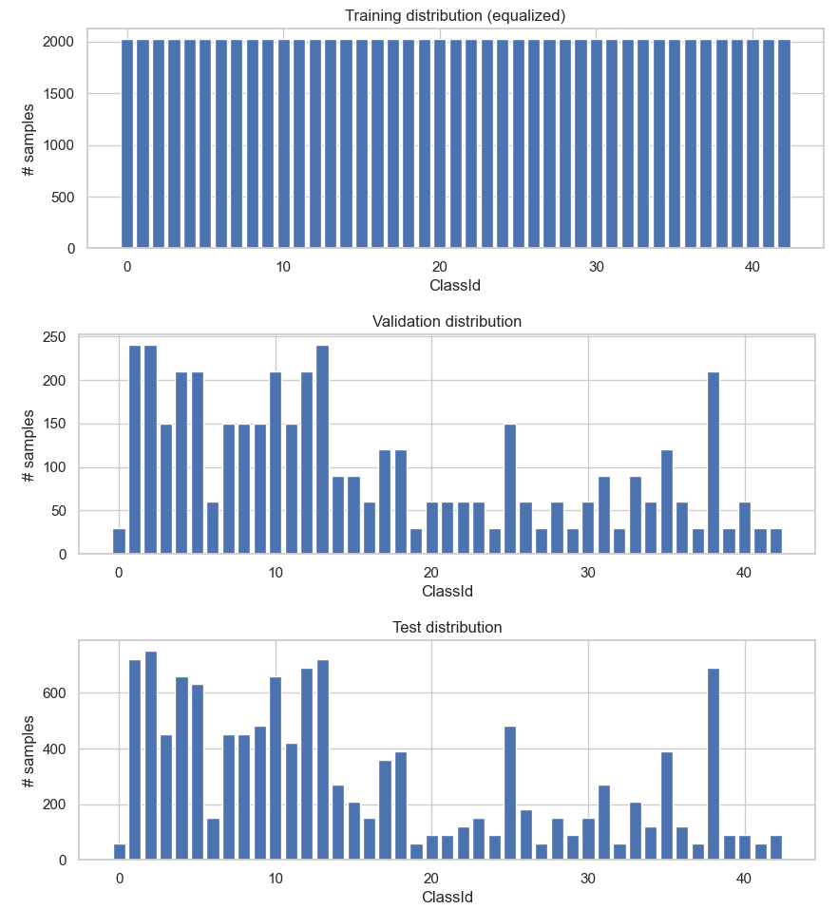
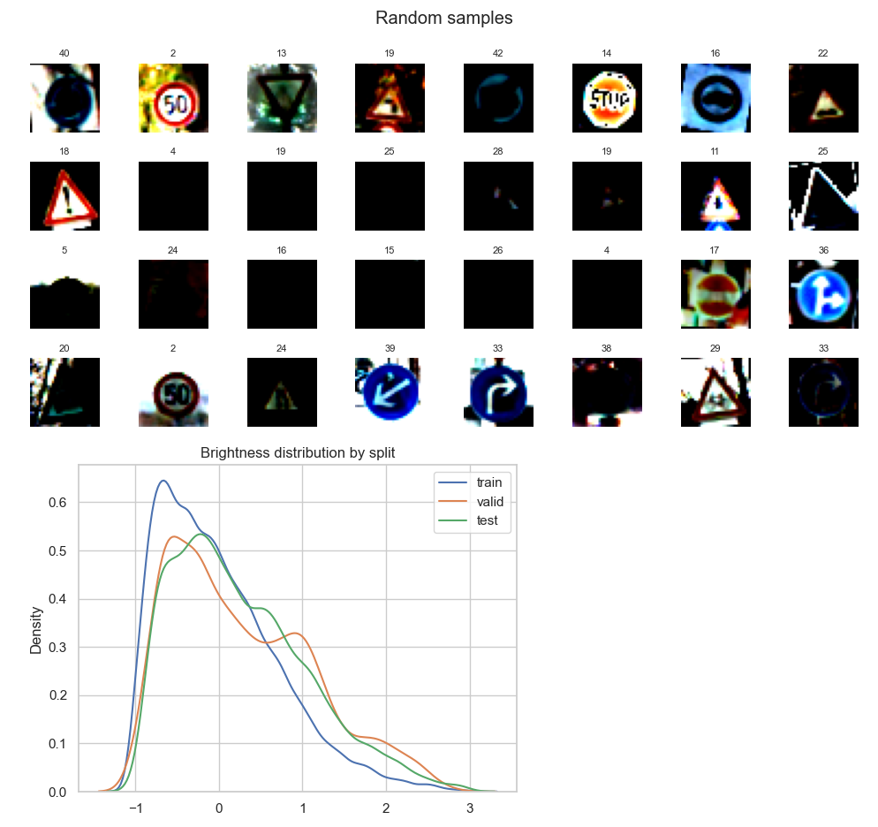
Project analysis slide 11
Exploratory Data Analysis
Notes:
“I first performed a quick EDA. The training distribution was equalized—about 2,000 samples per class—while validation and test sets showed natural imbalance. The random sample grid confirmed diverse sign types, orientations, and brightness levels. A brightness KDE plot showed the train set has slightly different brightness distribution compared to validation and test, which may explain generalization challenges later.”

Slide 5
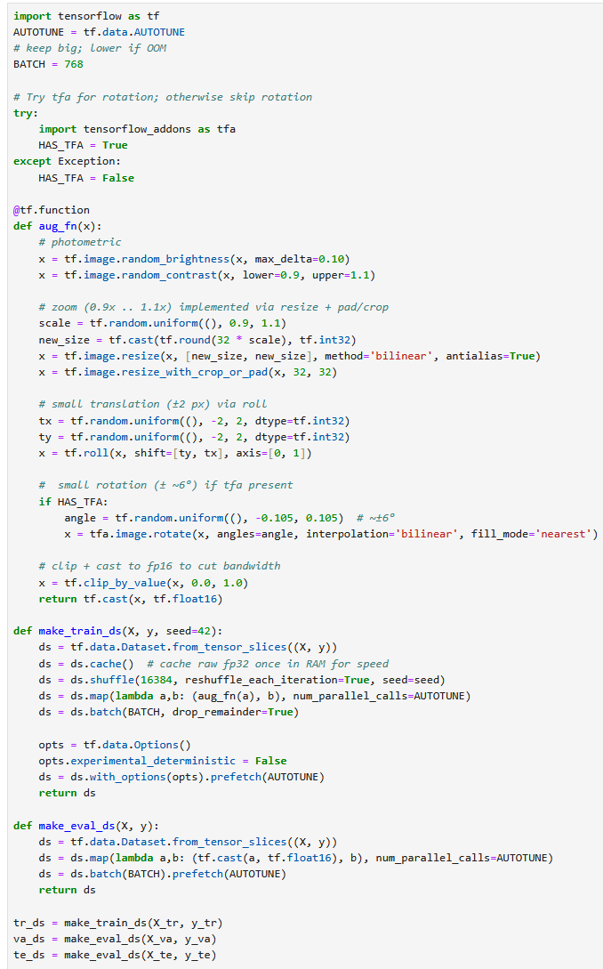
Project analysis slide 11
Data Augmentation & Pipeline
Notes:
“To improve generalization, I built a TensorFlow data pipeline using tf.data. I applied augmentations such as:
Random brightness and contrast changes.
Zooming and resizing between 90–110%.
Small translations (±2 px) and rotations (~±6°). These augmentations simulate real-world variations like camera shake or different lighting. The pipeline caches, shuffles, batches, and prefetches data for GPU efficiency and faster throughput.”

Slide 6
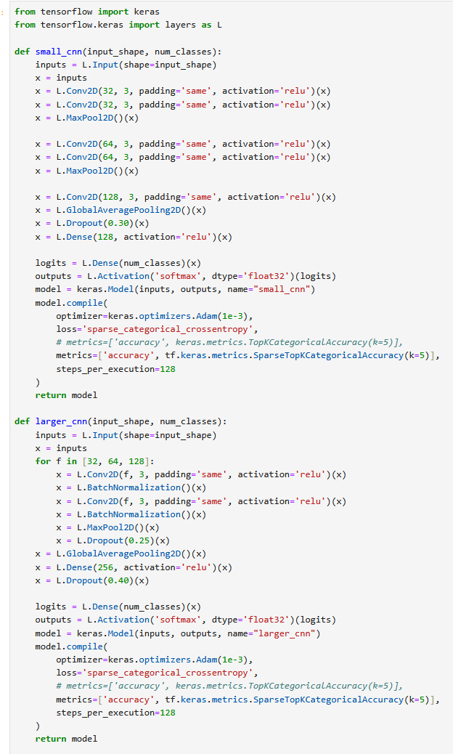
Project analysis slide 11
Model Architectures
Notes:
“I implemented and compared two CNN architectures:
Small CNN – Three convolutional blocks, global average pooling, and a single dense layer.
Larger CNN – Three deeper convolutional stages with batch normalization and dropout layers, followed by a 256-unit dense layer. Both used the Adam optimizer and sparse_categorical_crossentropy loss. I also tracked Top-5 accuracy for a more forgiving metric.”

Slide 7
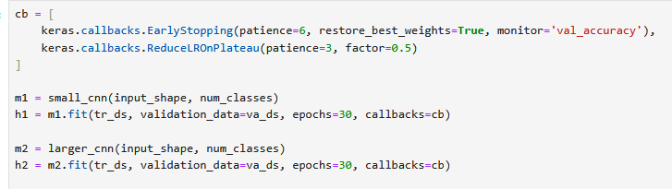
Project analysis slide 11
Training Setup
Notes:
“I trained both models for up to 30 epochs using early stopping with a patience of 6 to prevent overfitting and ReduceLROnPlateau to lower the learning rate when validation accuracy plateaued. The batch size was set to 768 to utilize the GPU fully, and mixed precision (float16) improved performance on my NVIDIA 3090.”

Slide 8
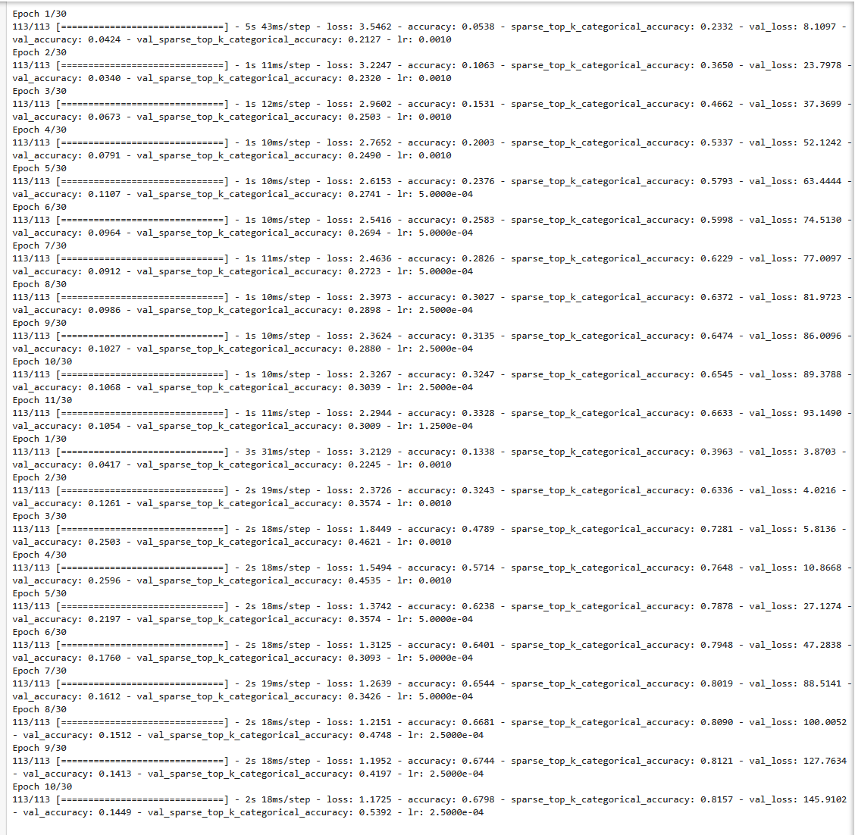
Project analysis slide 11
Training Results
Notes:
“The larger CNN quickly outperformed the smaller one. Validation accuracy plateaued around 24–26%, which is relatively low, showing the difficulty of this task without extensive fine-tuning or pretraining. The small CNN struggled more, peaking at only ~9–10%. While these accuracies are below state-of-the-art, they demonstrate the workflow from data to training under course constraints.”

Slide 9
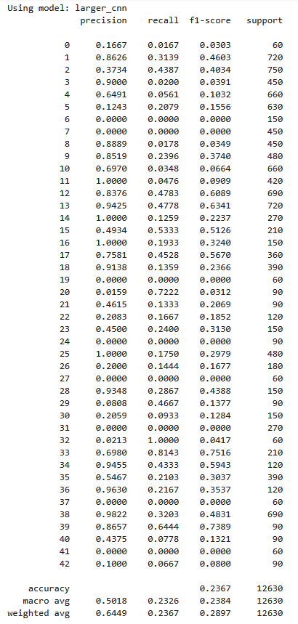
Project analysis slide 11
Evaluation: Classification Report
Notes:
“On the test set, the larger CNN achieved 21.6% overall accuracy. The classification report shows significant variation across classes:
Some signs like Class 12 (‘Priority road’) achieved 52% F1,
Others like Classes 5, 6, and 31 were never predicted, leading to undefined precision. The macro average F1 was 0.1794, highlighting imbalance and misclassifications.”

Slide 10
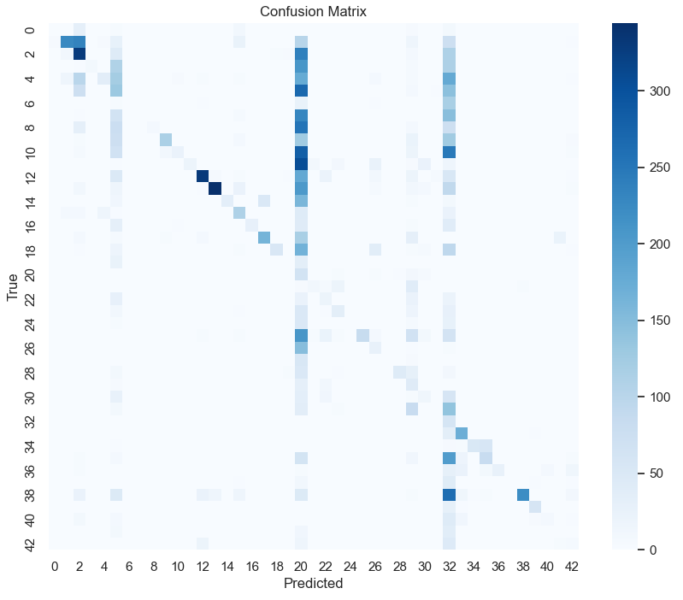
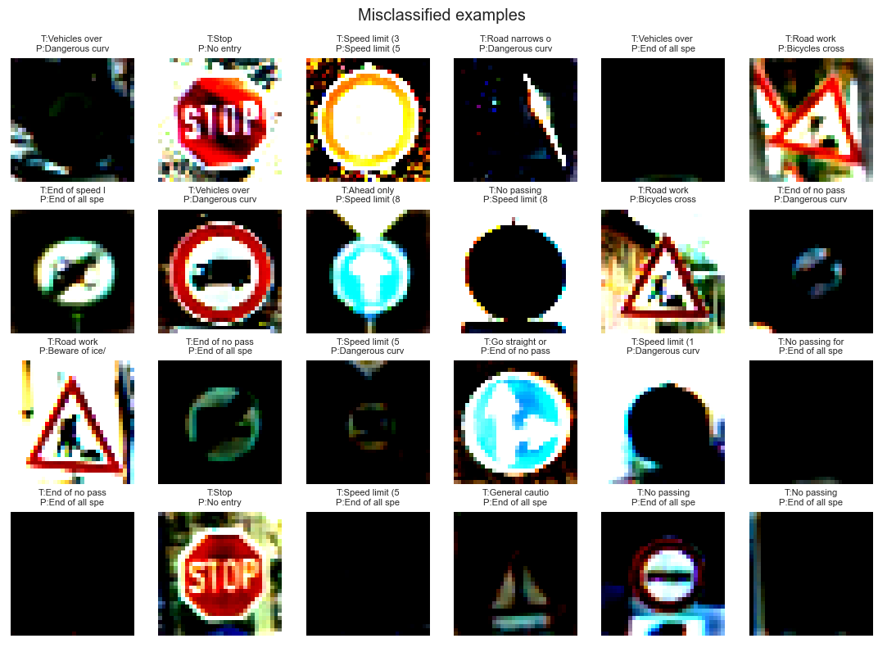
Project analysis slide 11
Evaluation: Confusion Matrix & Misclassifications
Notes:
“The confusion matrix reveals heavy misclassification toward certain dominant predictions, especially Class 38, which many unrelated signs were confused with. The misclassification gallery confirms that occlusion, poor lighting, and similar shapes caused many errors. For instance, a slippery-road triangle was misread as ‘Keep right.’”

Slide 11
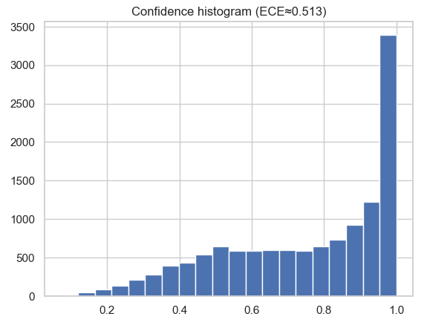
Project analysis slide 11
Additional Metrics
Notes:
“I computed top confusions by count and normalized rate—most frequent errors occurred between signs with similar triangular warning shapes. The per-class precision/recall plot shows large gaps: some classes approached 1.0 precision, but most had poor recall. The ECE (Expected Calibration Error) was 0.611, meaning the model was overconfident even when wrong. This is visible in the confidence histogram, where many predictions are near 1.0 probability despite poor accuracy.”

Slide 12
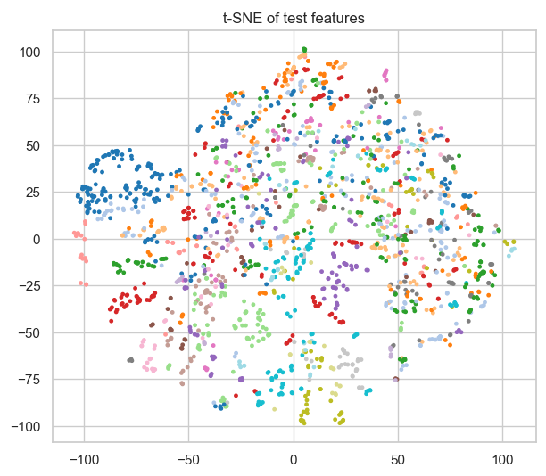
Project analysis slide 11
Feature Visualization
Notes:
“To explore the learned representations, I extracted features from the penultimate layer and applied t-SNE for dimensionality reduction. The resulting scatter plot shows some clustering of similar traffic signs but significant overlap, indicating the model has not learned fully separable representations.”

Slide 13
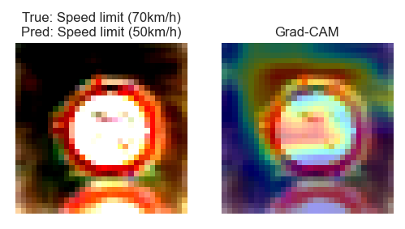
Project analysis slide 11
Grad-CAM Insights
Notes:
“Using Grad-CAM, I visualized which pixels influenced predictions. In this example, the model focused on the triangle edges and background noise instead of the slippery-road symbol—explaining the incorrect ‘Keep right’ prediction. Grad-CAM is a powerful tool for debugging and understanding deep networks’ decision-making.”

Slide 14
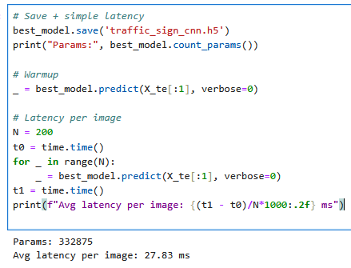
Project analysis slide 11
Latency & Deployment
Notes:
“I saved the best model as traffic_sign_cnn.h5 and measured inference latency. The model has ~333k parameters and runs at ~28 ms per image on a 3090 GPU—about 35 FPS, which is close to real-time. For deployment, we could optimize further using TensorRT or TFLite quantization.”

Slide 15

Project analysis slide 11
Discussion & Possible Improvements
Notes:
“Several factors limited performance:
The small image size (32×32) and lack of pretraining.
Validation and test splits were class-imbalanced.
More sophisticated augmentations, transfer learning from pretrained backbones like MobileNet, or longer training could help.
Adding techniques like label smoothing, learning rate schedules, or ensemble models could improve accuracy.”

Slide 16
Conclusions
Notes:
“This project demonstrates a full deep learning workflow: data preparation, EDA, augmentation, model design, training, evaluation, and visualization. Even though the model underperforms state-of-the-art results on GTSRB, it meets the course goals by:
Building and training two CNNs.
Exploring class imbalance and model weaknesses through confusion matrices, Grad-CAM, t-SNE, and calibration.
Evaluating latency for real-time use cases.
In a production scenario, I would incorporate transfer learning and more advanced hyperparameter tuning.”
“Thank you for listening. This concludes my presentation on traffic sign classification. I look forward to any questions or feedback on my approach.”

